Slide 1
Object Oriented Programming Lab CSE 1206
LAB 1

Slide 2
Course Teacher Dr. Shahriar Mahbub, Professor Nowshin Nawar Arony, Lecturer Md. Hasin Abrar, Lecturer Md. Tanvir Rouf Shawon, Lecturer

Slide 3
JDK Installation
The Java Development Kit (JDK) is a software development environment used for developing Java applications
Download Link:
http://www.oracle.com/technetwork/java/javase/downloads/jdk8-downloads-2133151.html
Setting JDK and JRE path on your computer:
https://www.youtube.com/watch?v=pgr-Bzkc4zg

Slide 4
Setting JDK and JRE path
Install the JDK file on your computer.
Go to C drive -> Program Files -> Java -> jdk folder -> bin
copy this path
Go to System -> Advance system settings -> Environment Variables
double click on path under System variables
Type ; (semi-colon) and paste the jdk path
Go to C drive -> Program Files -> Java -> jre folder -> bin
paste this path in the way similar to jdk path.

Slide 5
Java Program Execution States
Platform Dependent
myprog.c
myprog.exe
gcc
Machine Code
C source code
OS/Hardware
Platform Independent
myprog.java
javac
myprog.class
Java source code
bytecode
JVM
OS/Hardware

Slide 6
Java Program Compilation
Java Code
Compiler
Byte Code
Sample.java
Sample.class

Slide 7
Runtime of a Java Program
Class File
Class Loader
Byte Code Verification
Runtime
Interpreter
Hardware
JVM

Slide 8
Java Virtual Machine
# JVM loads byte codes
# verifies the byte codes
Uninitialized variables
Access rules for private data and methods are not violated
Method calls match the object reference
etc
# execute code
# provides runtime environment

Slide 9
Java Virtual Machine
Memory Area
Class file format
Register Set
Garbage collected heap
Fatal error reporting etc.

Slide 10
Java Runtime Environment
Set of libraries
e.g. rt,jar etc
JVM
Other files
JRE

Slide 11
Java Development Kit (JDK)
Set of libraries
e.g. rt,jar etc
Development tools
e.g. java,javac etc.
JVM
Other files
JRE
JDK

Slide 12
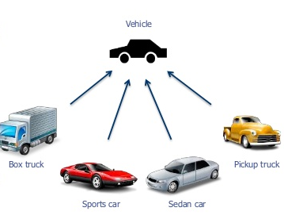
Java class and Object

Slide 13
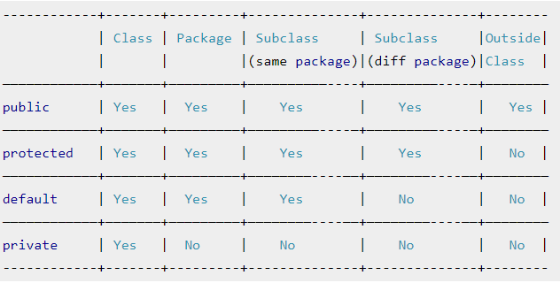
Access Modifiers

Slide 14
Sample Java program
Open notepad/ notepad++ and copy the following code there. Save the file with the name Hello.java
You must remove the .txt extension.
public class Hello {
public static void main(String[] args) {
System.out.println("Hello Java");
}
}

Slide 15
Run from CMD (command prompt)
Type in the command prompt window.
pushd address of the path of the java file
[ pushd stands for push directory, used to push the path where java file has been saved]
set path=“C:\Program Files\Java\jdk1.8.0_77\bin”
javac Hello.java
java Hello
*Additional command if required:
cd.. [cd stands for change directory].

Slide 16
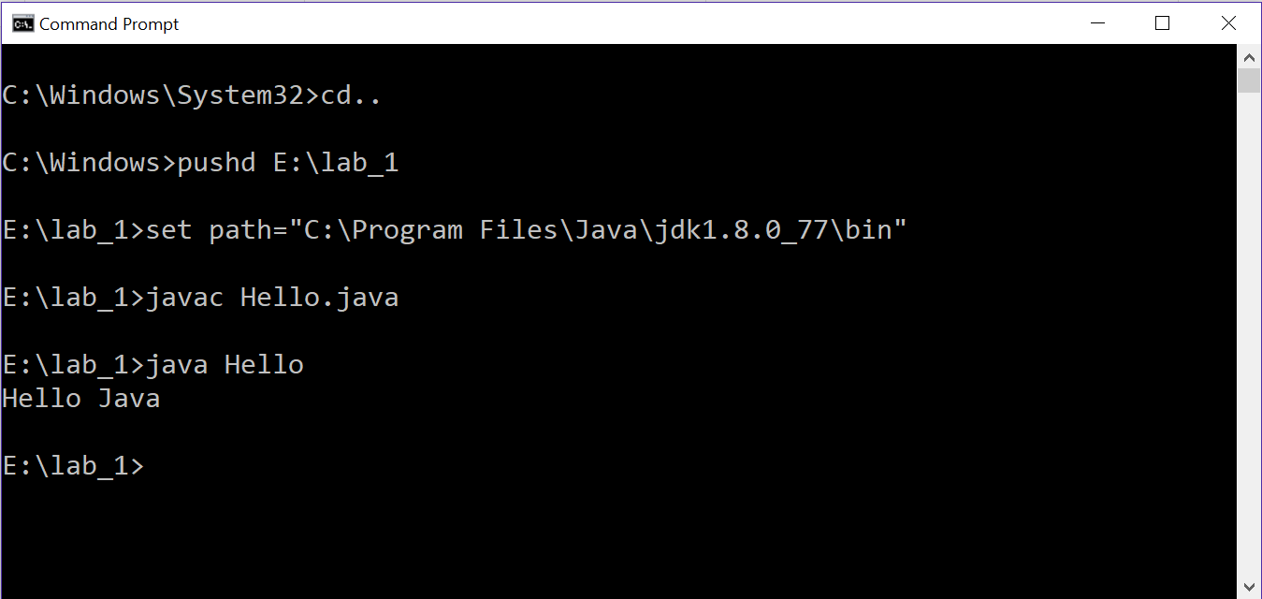

Slide 17
Similar to C programming language
Comments: Single-line (//), Multiline (/* and */)
Data types: int, float, double, char, boolean, String
Operators: + , - , * , / , = , == , > , < , % , ++ , -- , <= , >= ,
!= , && , || , ! , etc.
Conditional Statements: if, else, else if, switch, break, default

Slide 18
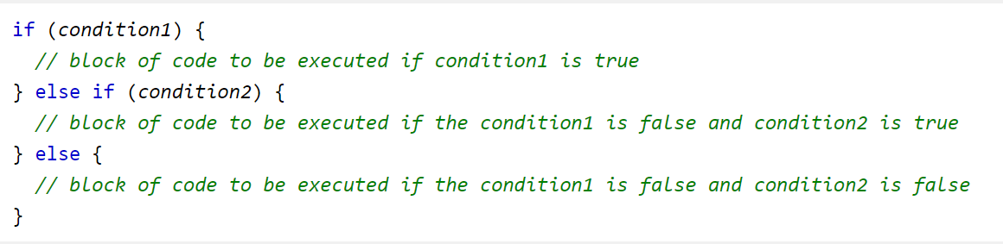
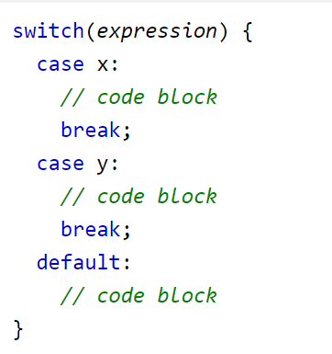

Slide 19
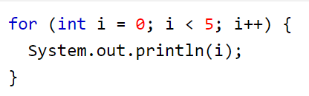
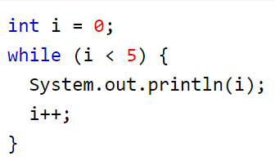
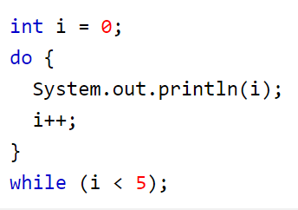
Similar to C programming language
Loop Statements: for , while , do while
break and continue statements: to break or continue loops

Slide 20
Basic Java Syntax
w3school:
https://www.w3schools.com/java/java_syntax.asp
Tutorials point:
https://www.tutorialspoint.com/java/java_basic_datatypes.htm

Slide 21
New Java Syntax
Java Strings: String str = "Hello";
https://www.w3schools.com/java/java_strings.asp
User Input:
https://www.w3schools.com/java/java_user_input.asp

Slide 22
import java.util.Scanner; // Import the Scanner class
class Hello {
public static void main(String[] args) {
Scanner myObj = new Scanner(System.in); // Create a Scanner object
System.out.println("Enter username");
String userName = myObj.nextLine(); // Read user input
System.out.println("Username is: " + userName); // Output user input
}
}

